Slide 1
Country Living
By Gerard and Shirley Fordham

Slide 2
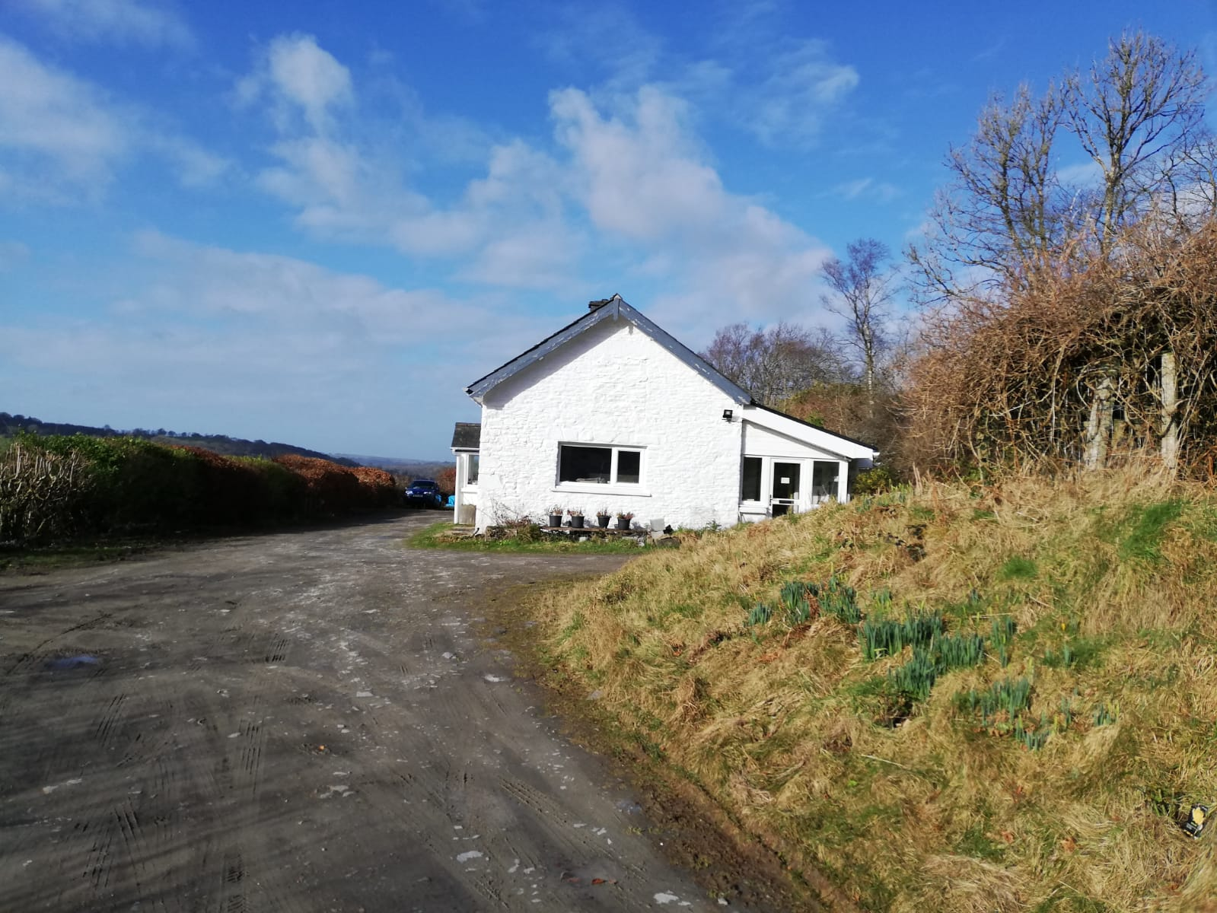

Slide 3
Websites
http://www.endtimepreparedness.org
Bro Meisner
www.sustainablepreparedness
By Bro Nick Meisner
http://www.backtoenoch.org
by Dave Westbrook.
http://www.preparingtostand.org by Jim Buller

Slide 4
"Again and again the Lord has instructed that our people are to take their families away from the cities, into the country, where they can raise their own provisions; for in the future the problem of buying and selling will be a very serious one." Country Living page 9 & 10.
The Lord has shown me clearly that the image of the beast will be formed before probation closes, for it is to be the great test for the people of God, by which their eternal destiny will be decided.-" Last Day Events p227& 228.

Slide 5
" We can and should have tact and knowledge in trades, in building, in planting, and in sowing. A knowledge of how to cultivate the land will make rough places much smoother." {19MR 26.2}

Slide 6
See also Counsels On Stewardship the chapter entitled "The Tyranny of Debt pages 249 to 283.
Also see Adventist Home the Chapter entitled "The Use Of Money pages 367 to 389.

Slide 7
WORK
1. Same type of job.
2. Working from home.
3. Related job in same field.
4. Previous skill.
5. Online business.
6. Small market gardening.

Slide 8
Ideal Property
1.Acreage 10+
2. Water
3. Access. Not too easy, not too hard.
4. Soil. Good for growing food.
5. Slope. SW ideal.
6. Timber.
7. Seclusion. No near neighbours.
8. Condition of house
A place you love.

Slide 9
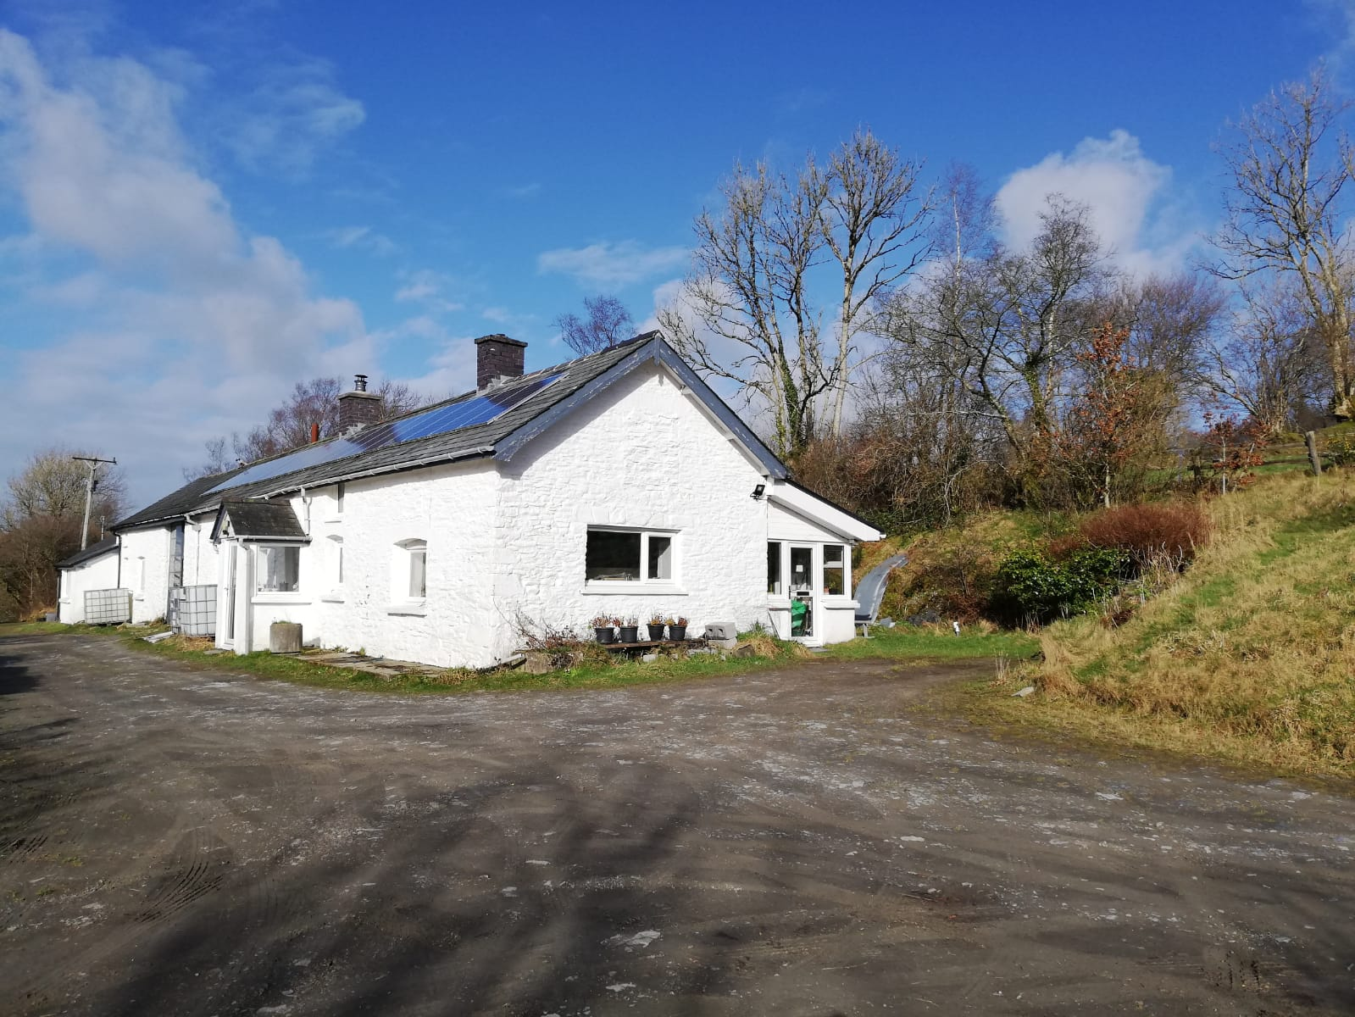

Slide 10
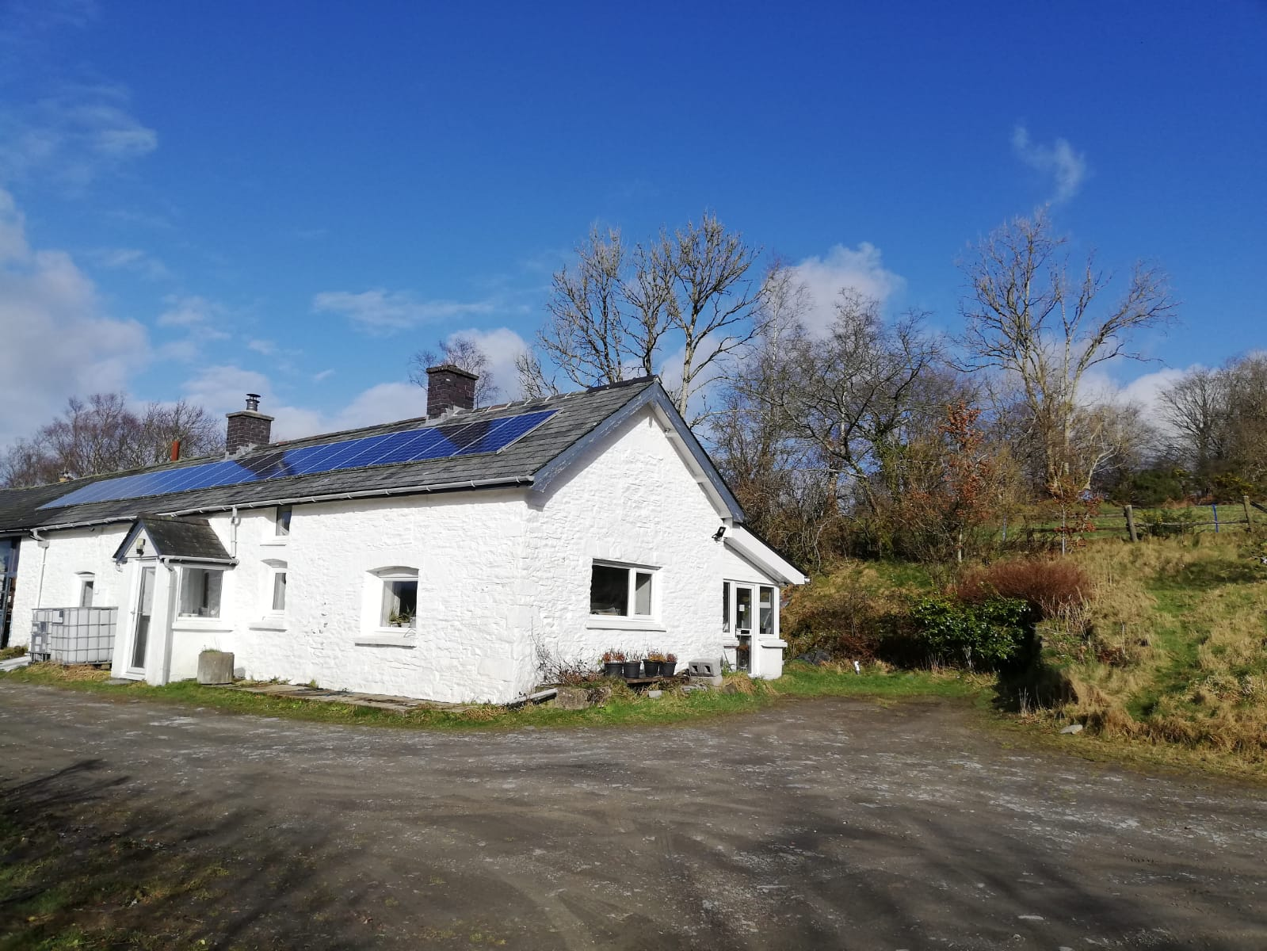

Slide 11
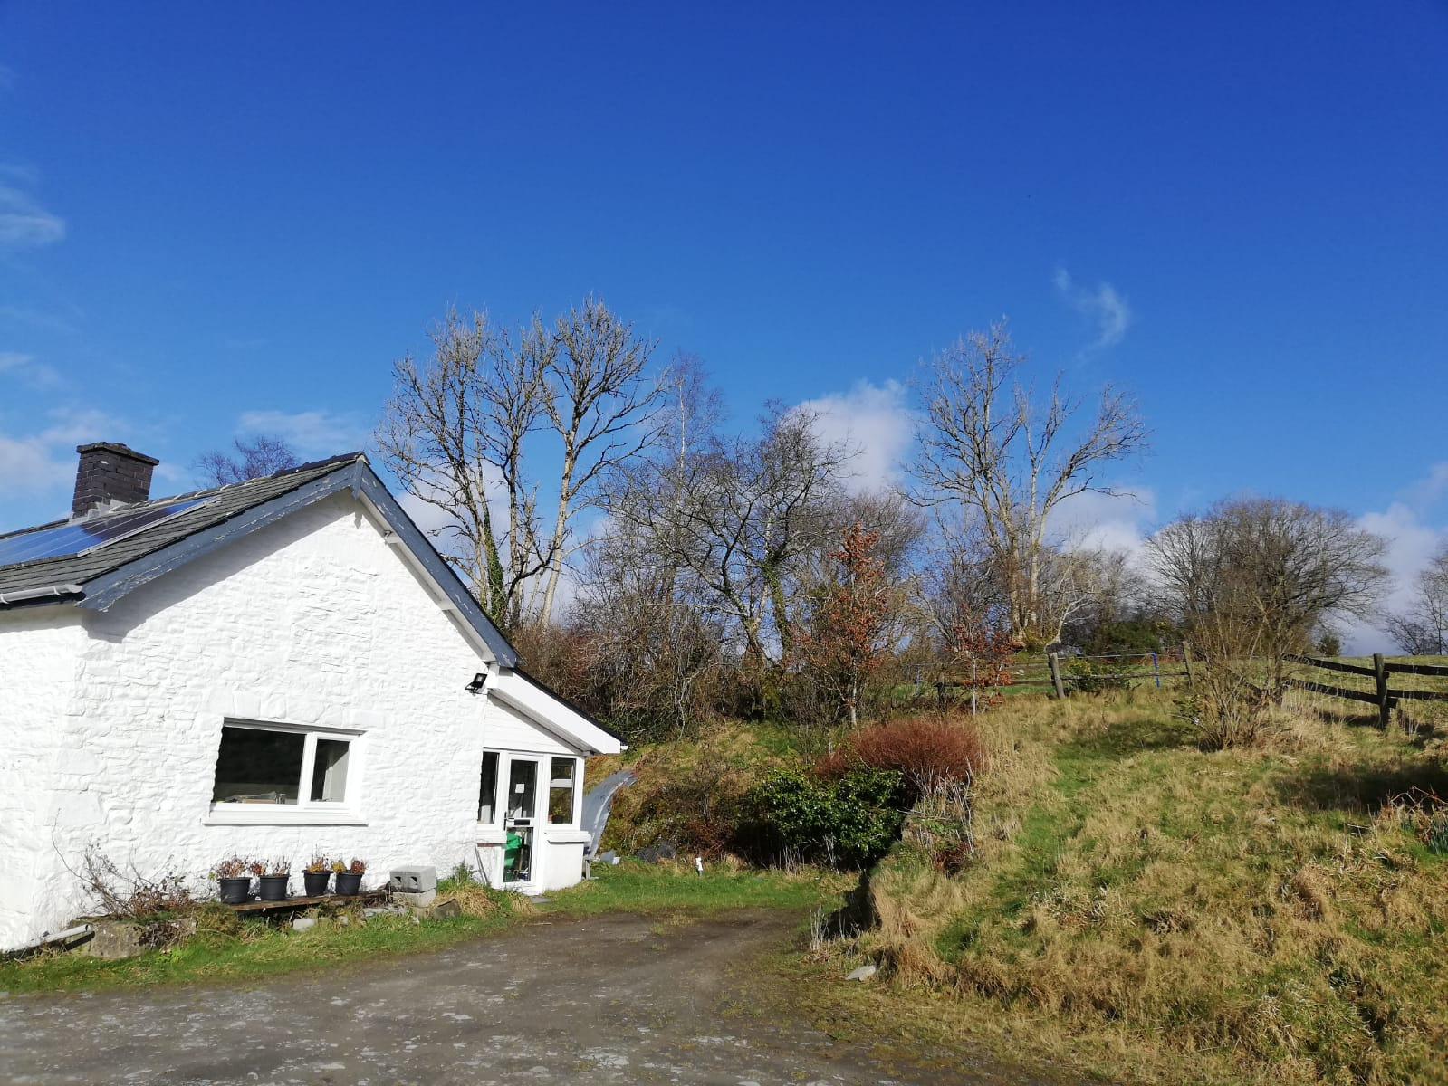

Slide 12
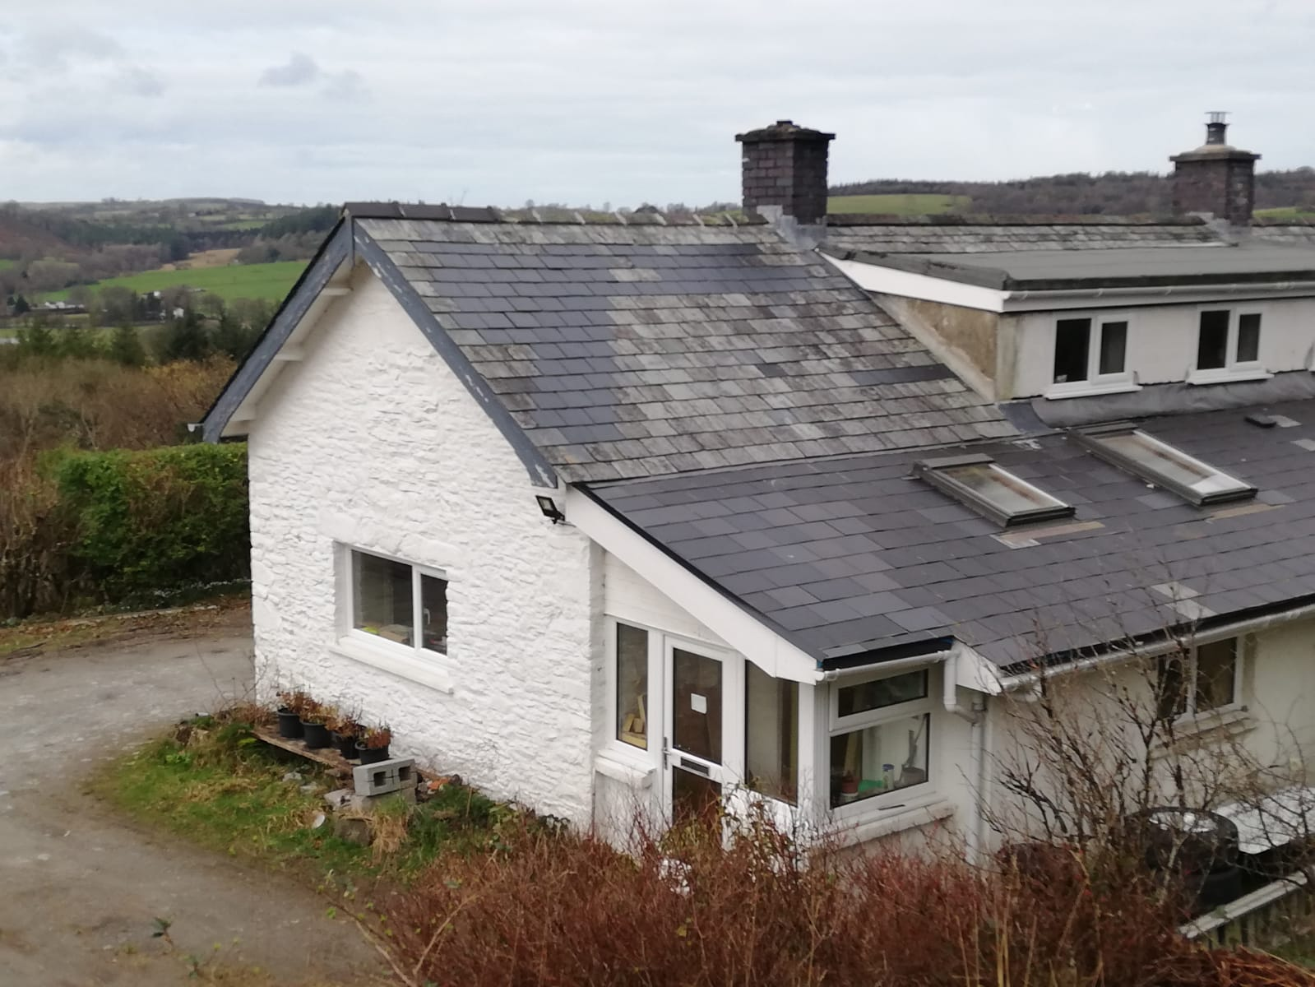

Slide 13
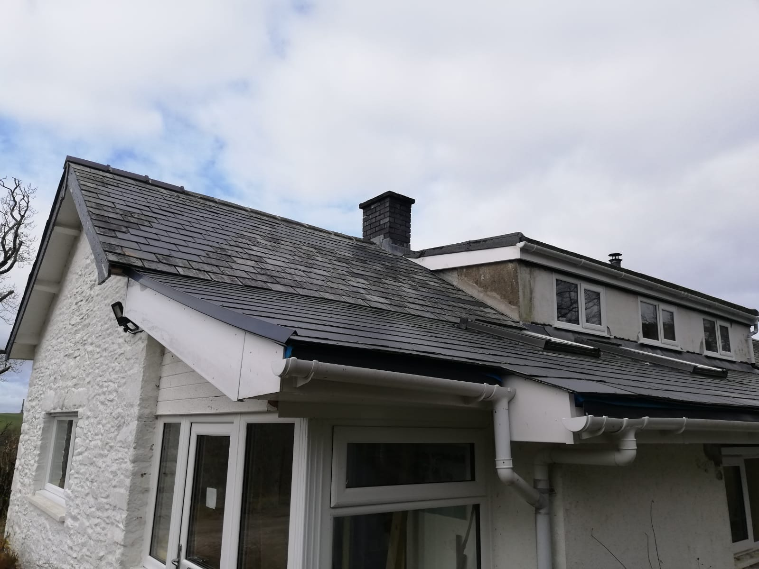

Slide 14
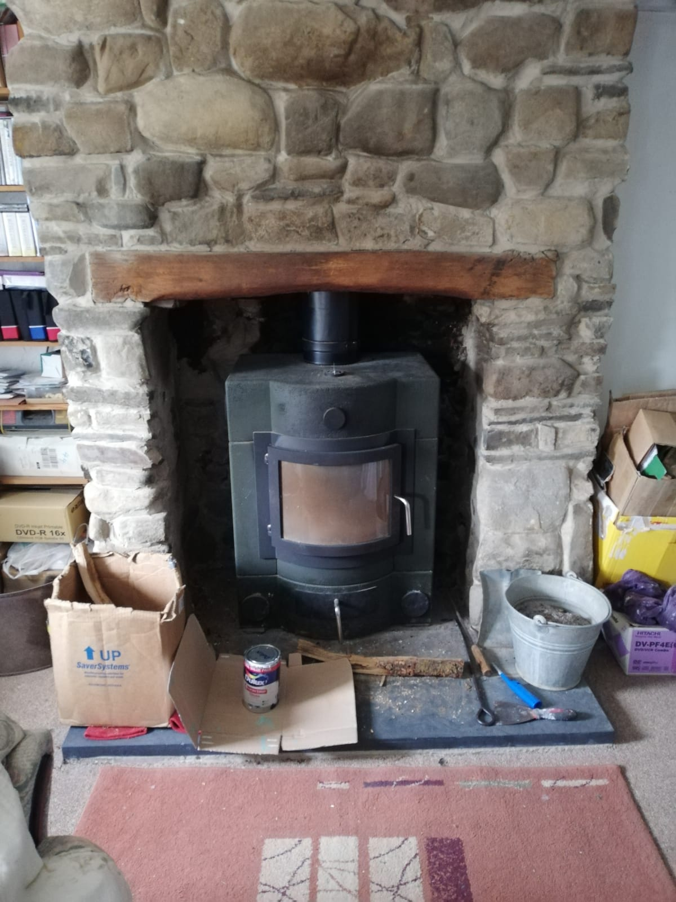

Slide 15
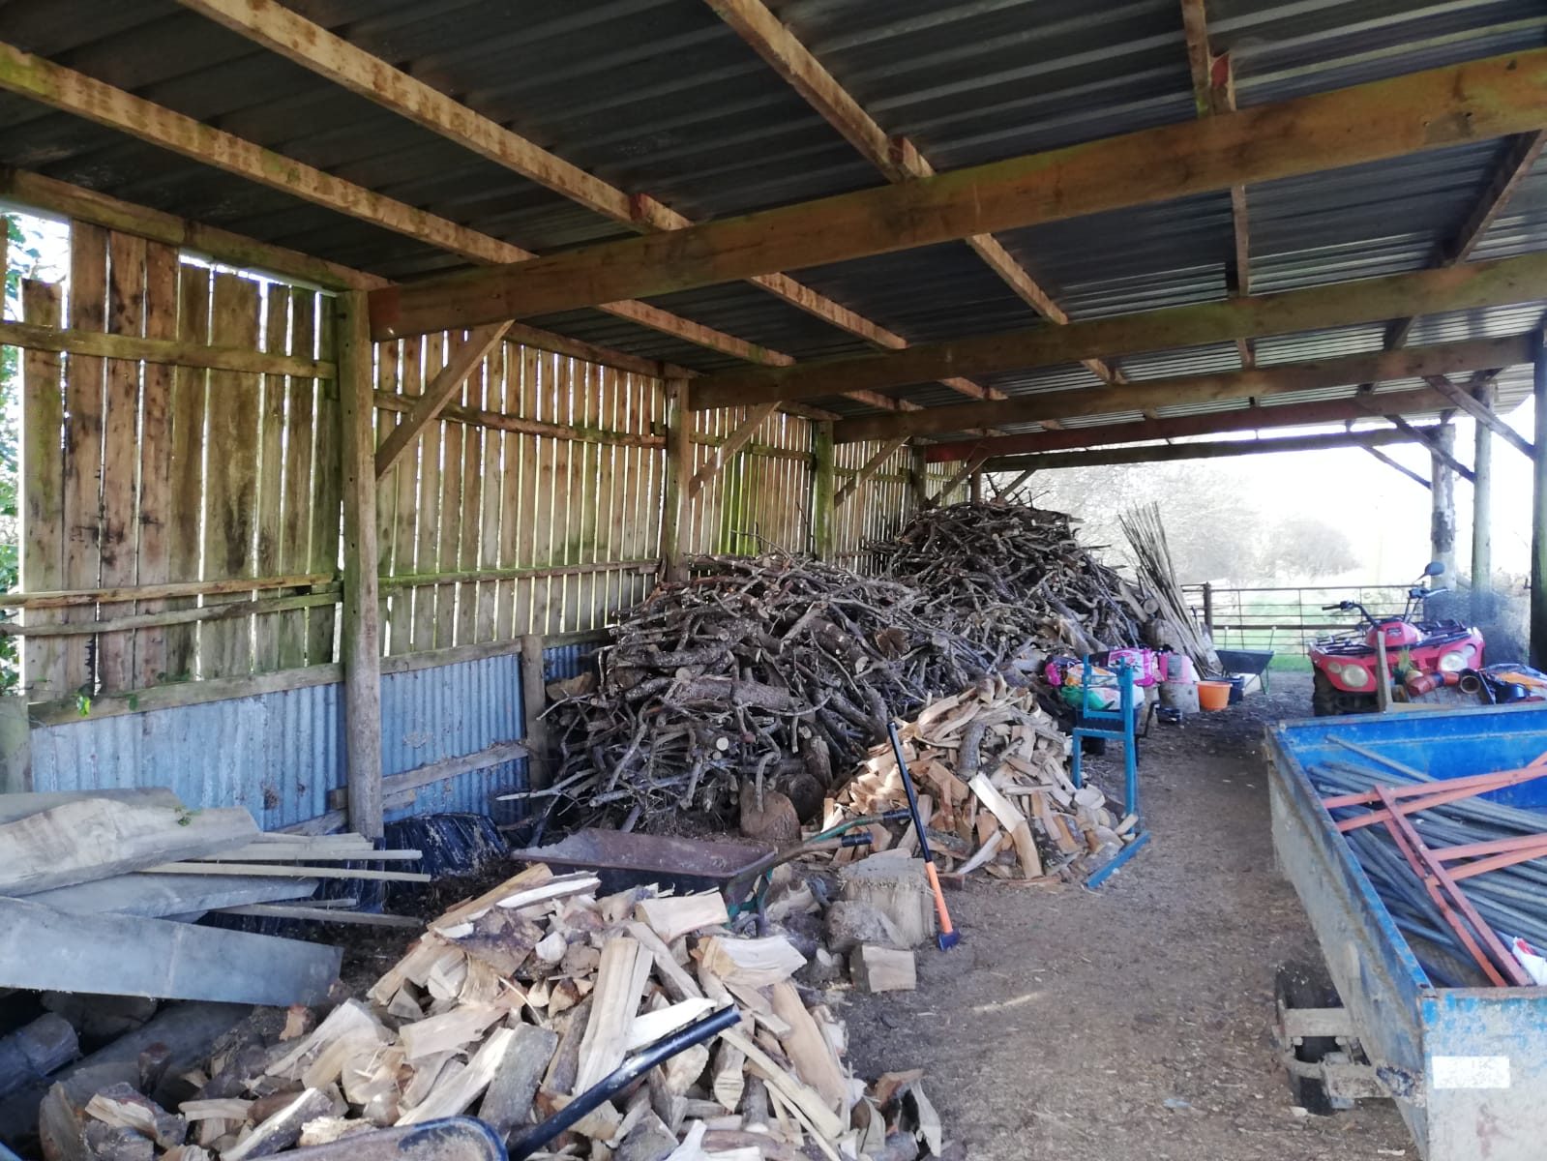

Slide 16
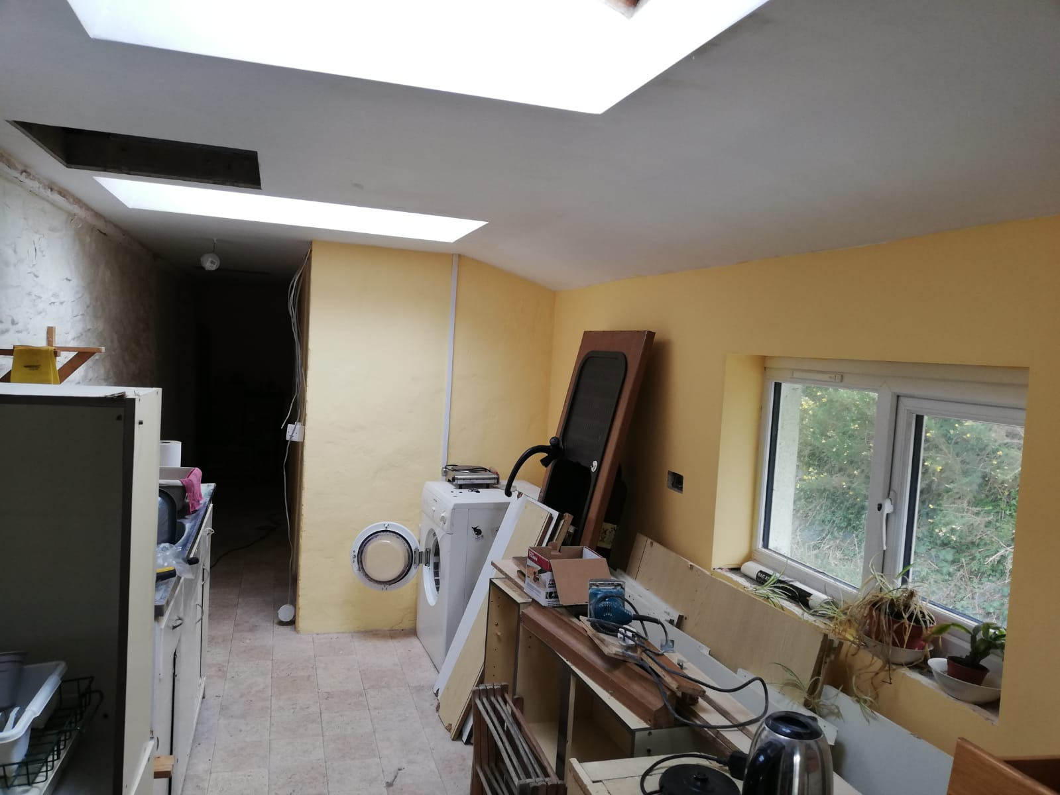

Slide 17
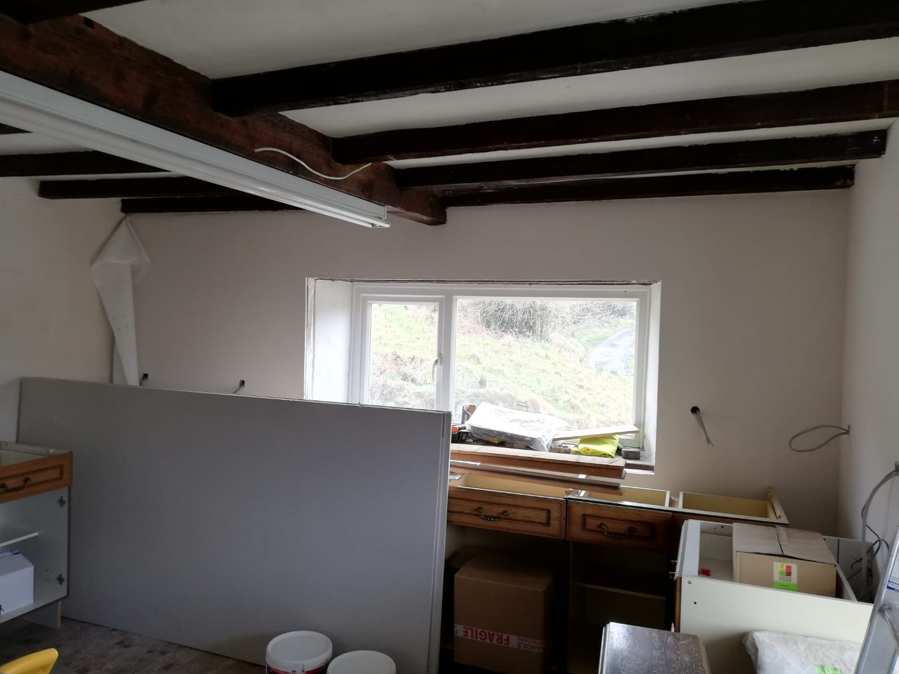

Slide 18
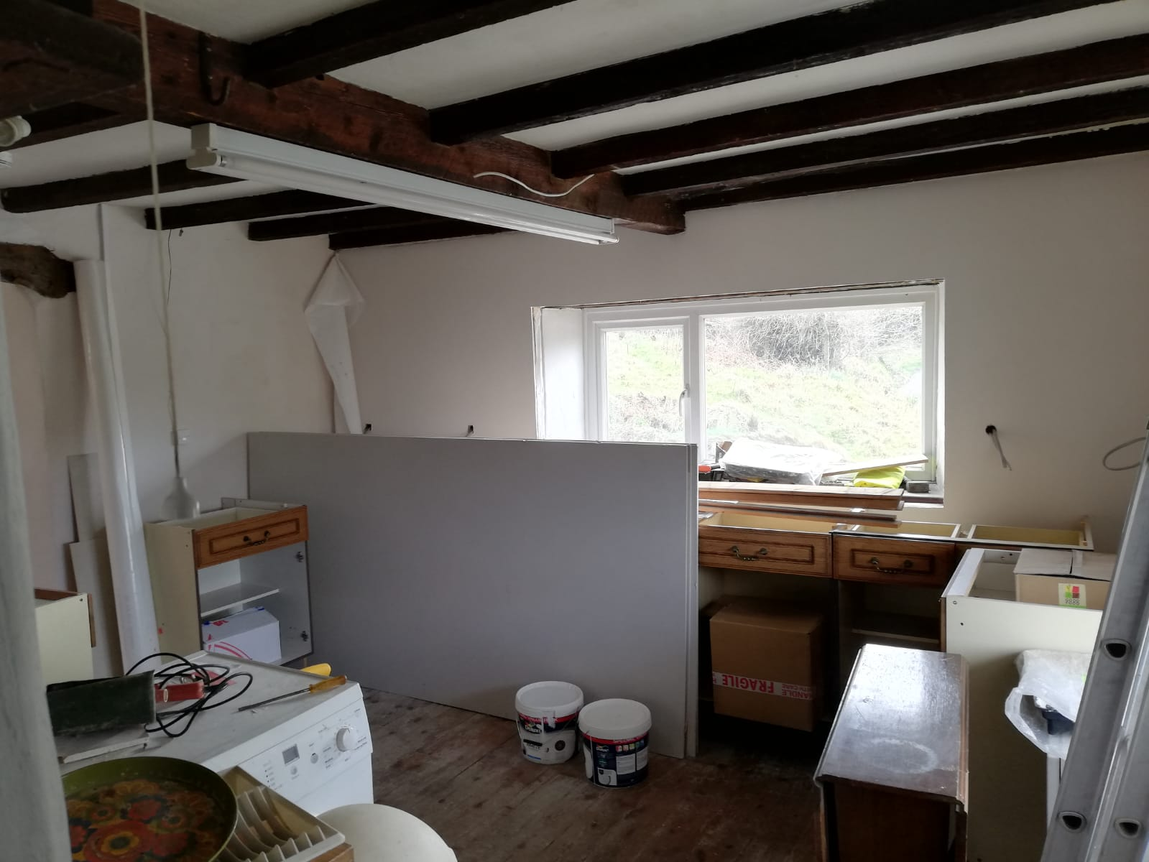

Slide 19
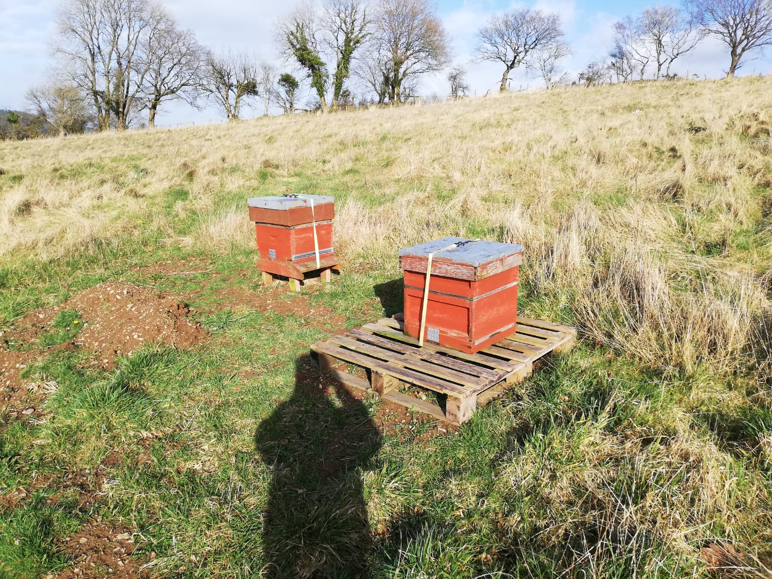

Slide 20
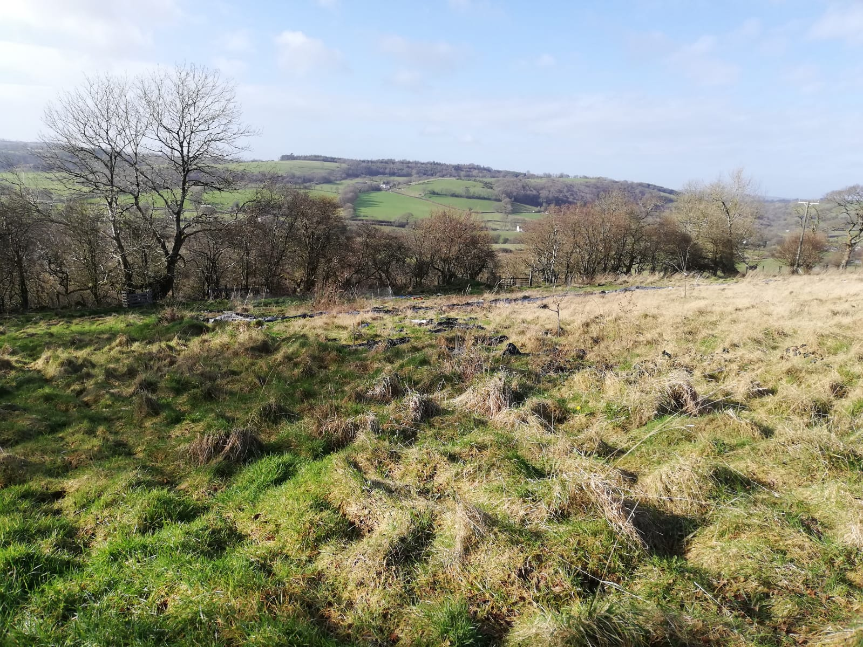

Slide 21
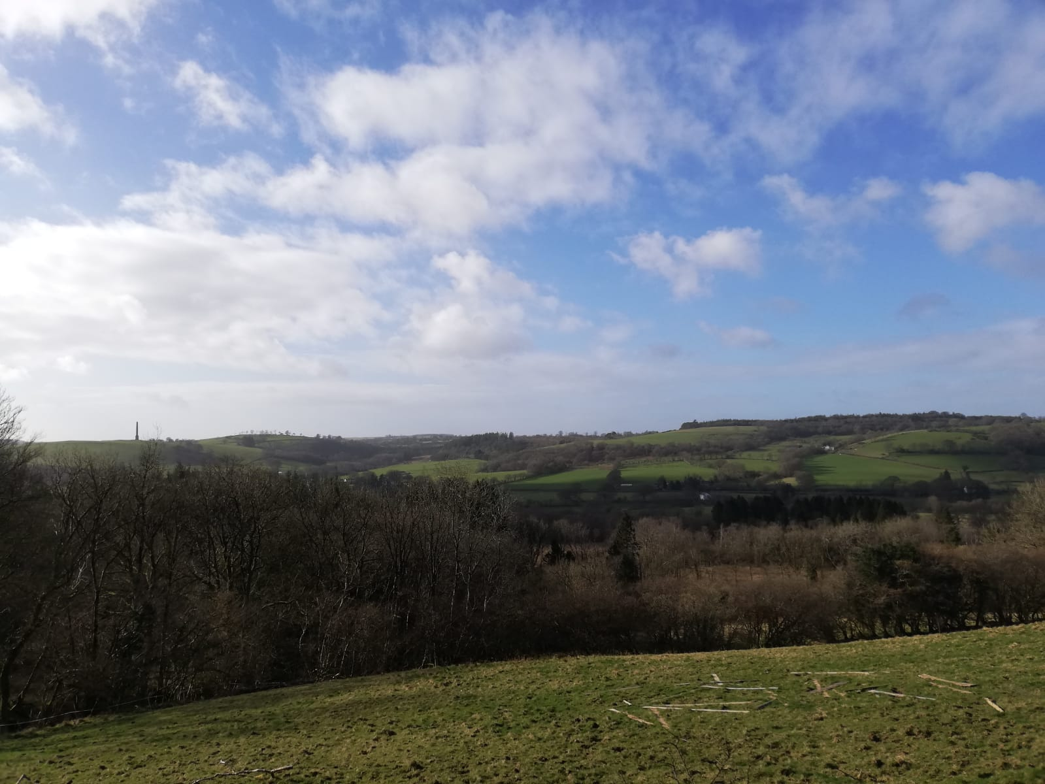

Slide 22
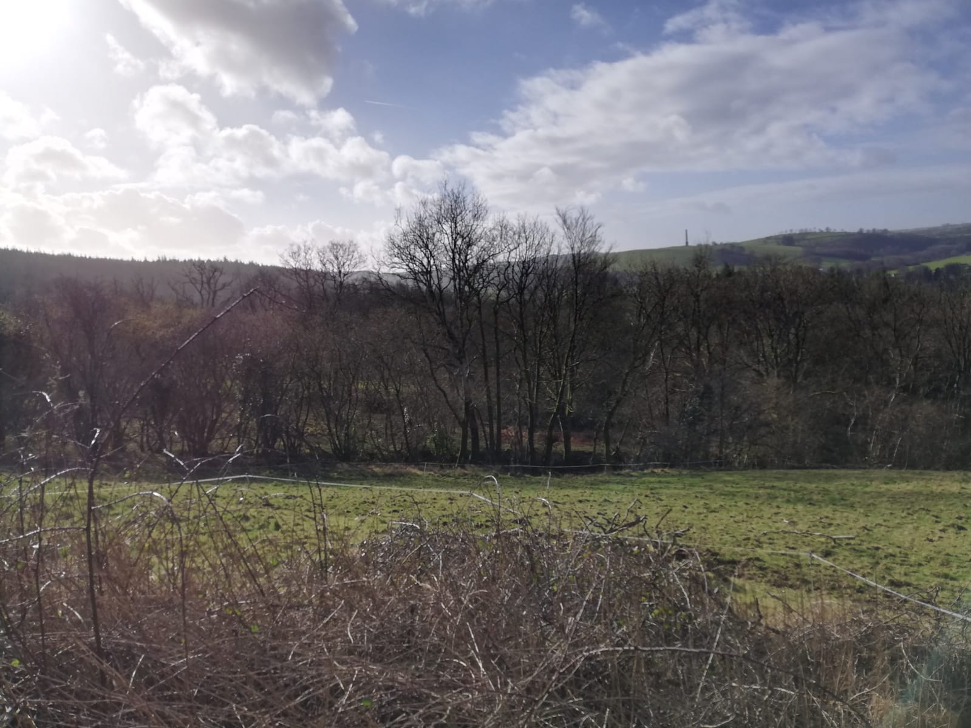

Slide 24
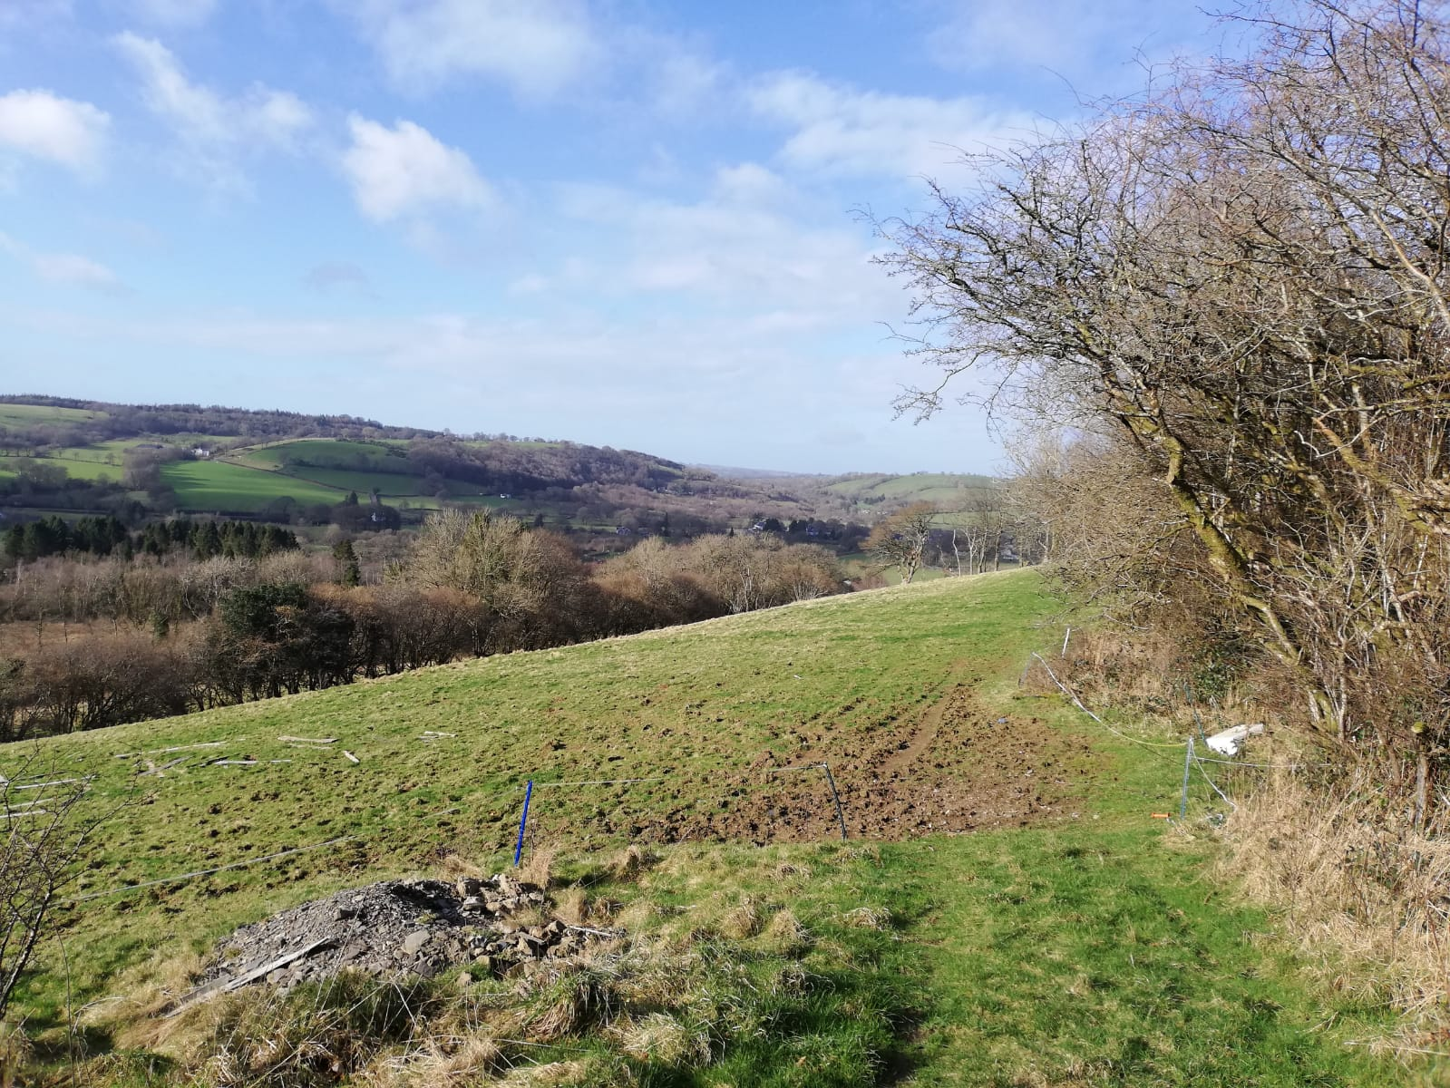

Slide 25
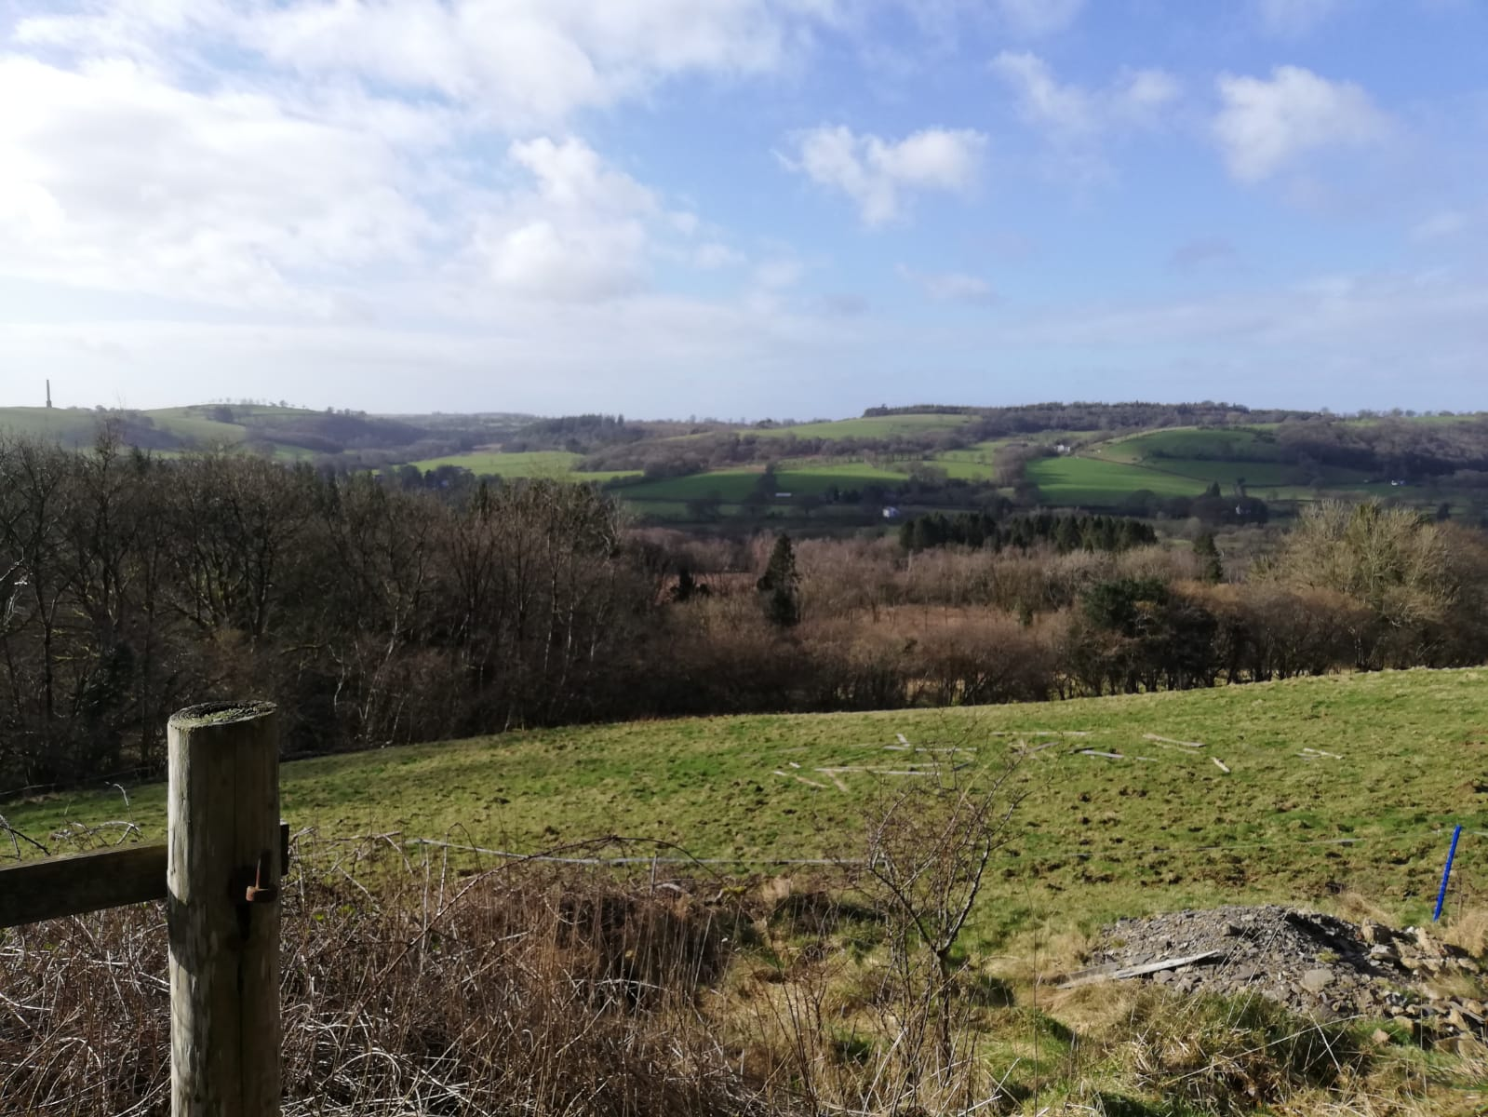

Slide 26
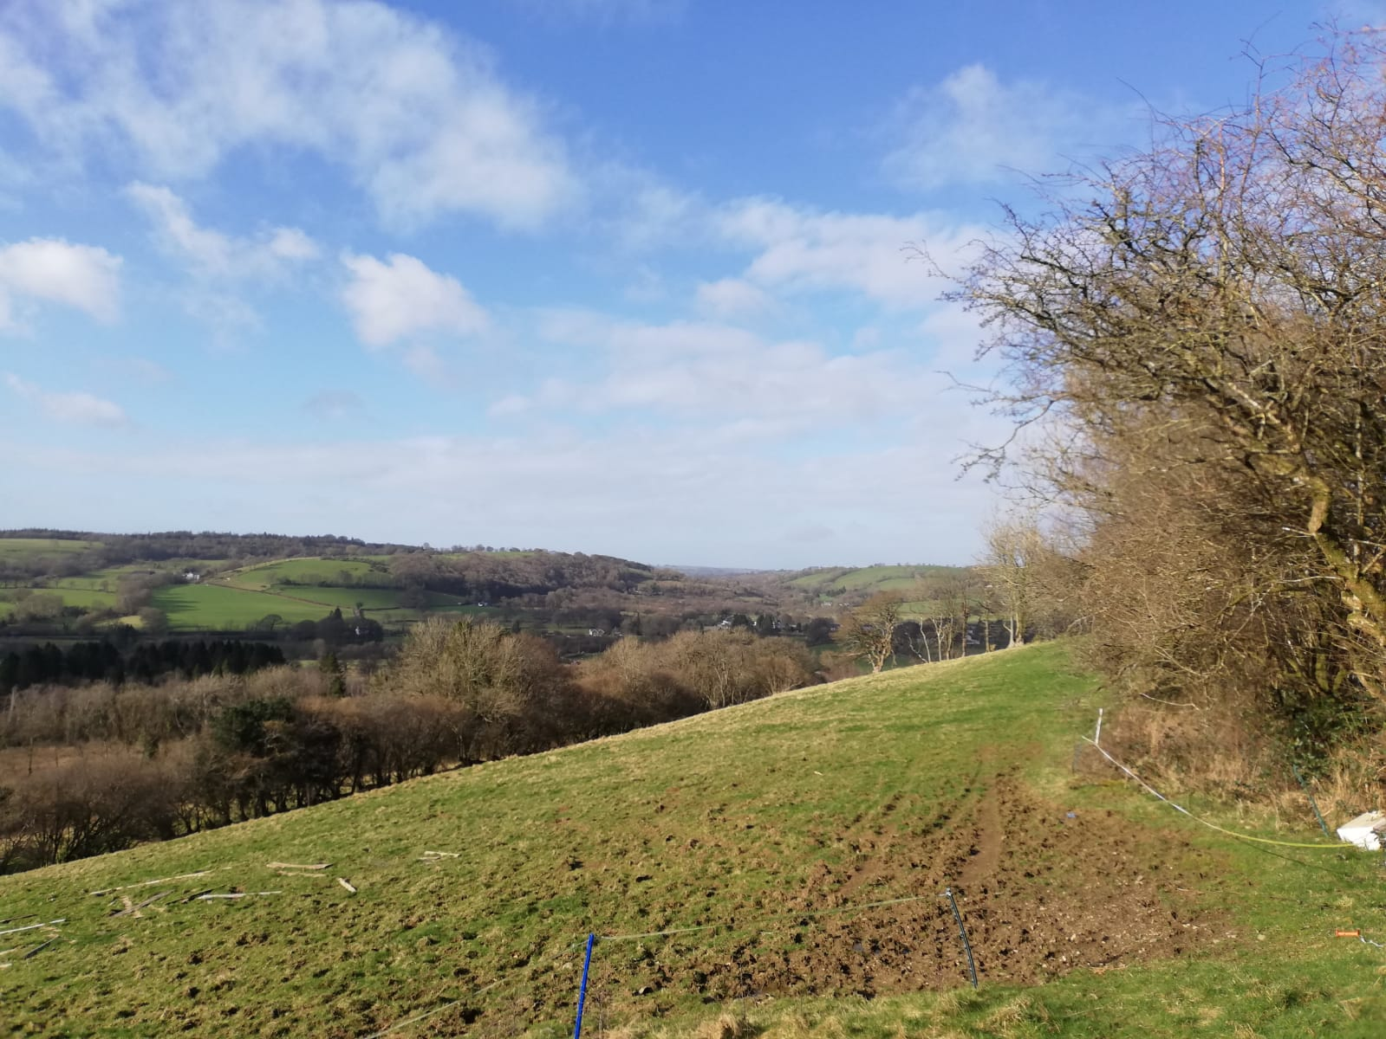

Slide 27
For further information please contact Shirley and Gerard Fordham on the following email address:
Gerard.Fordham@btinternet.com

